Slide 1
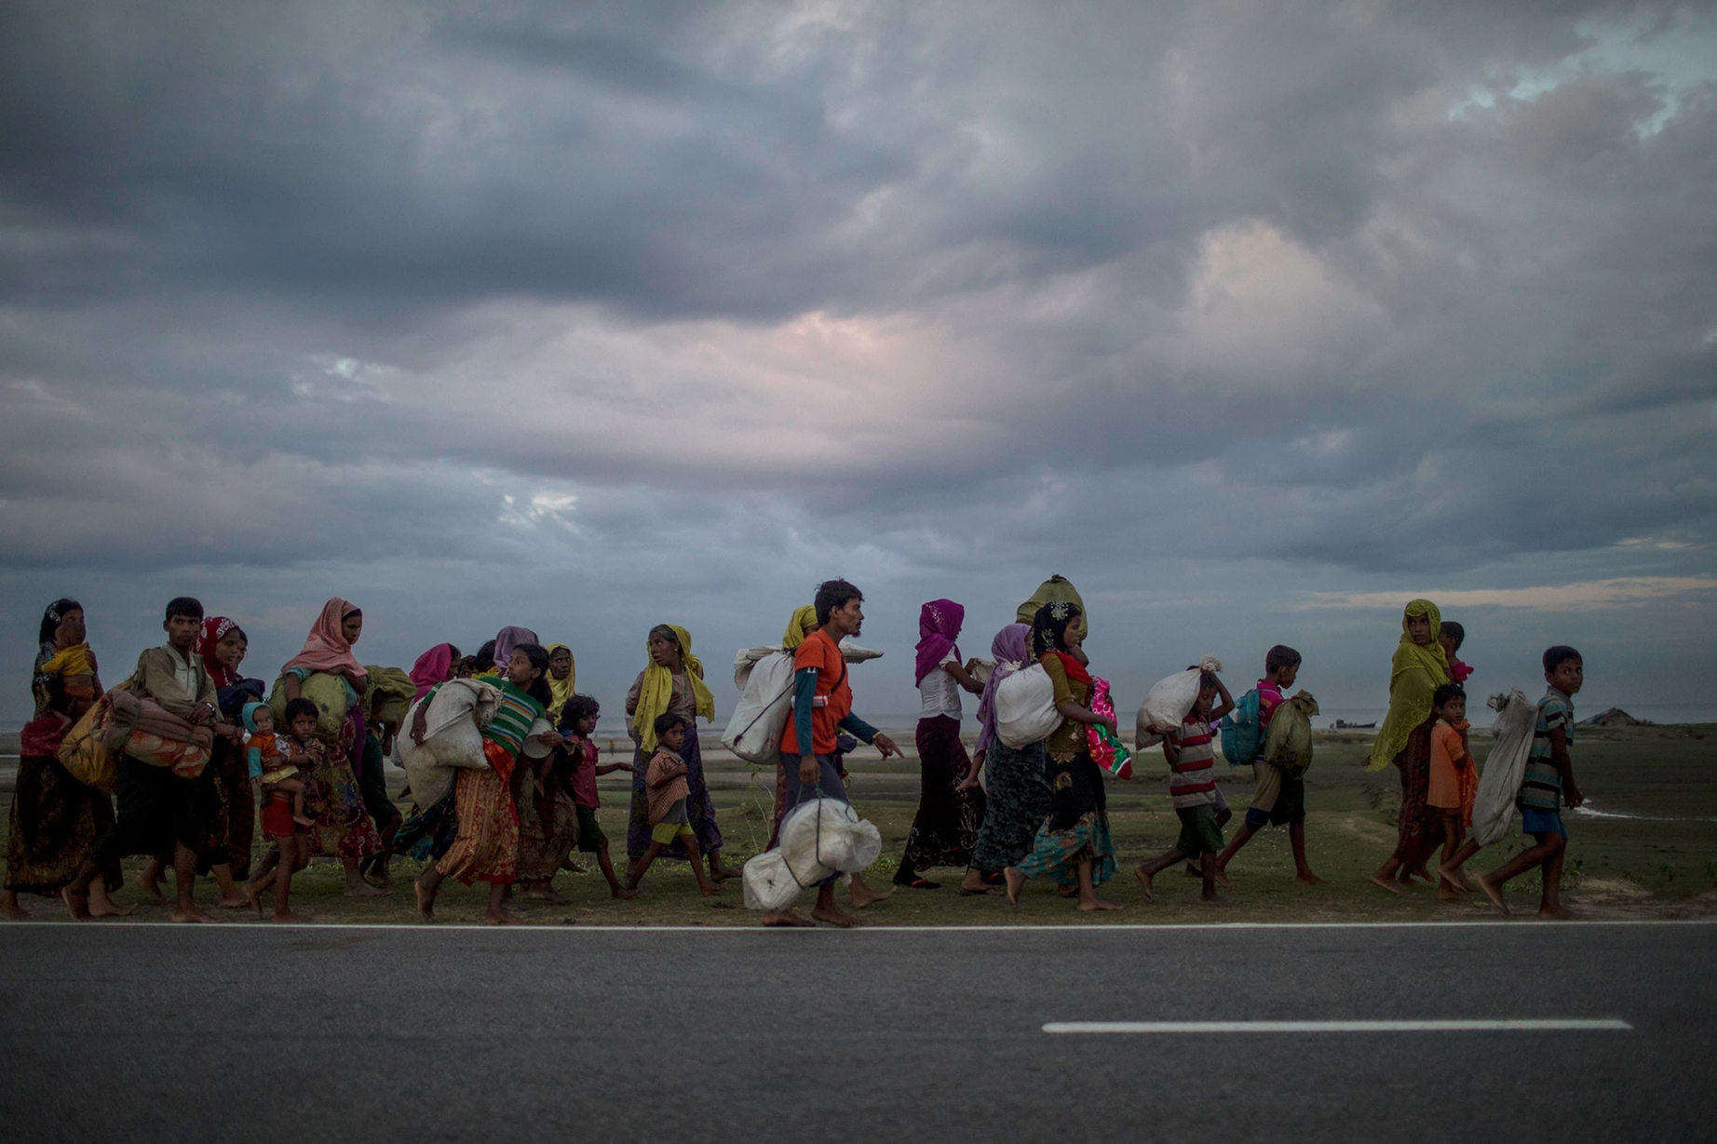
Understanding and forecasting forced migration
EscapeWar.Net Project

Slide 2
Main up-to-day challenges
If the world could be a better place
Our solution
Presenting the project
Business model
Contacts cause you are totally interested
Context
Everything we are going to talk about

Slide 3
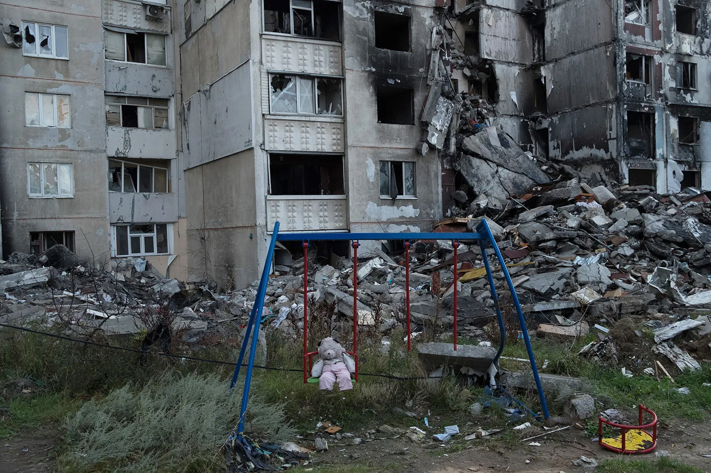



Problems detection
Risk to be trapped
Absence of humanitarian corridors and services
Unreliable danger data
Wars are waged by governments, but uninvolved civilians are affected hardest. Without a proper beforehand alert people are risking being trapped in an occupied area with no possibility to escape
Occupied zones are unreachable for humanitarian aid, these areas couldn`t provide an amount of food, water, and services enough for normal living
All the data given in open sources should be verified several times and cannot be trusted right away

Slide 4
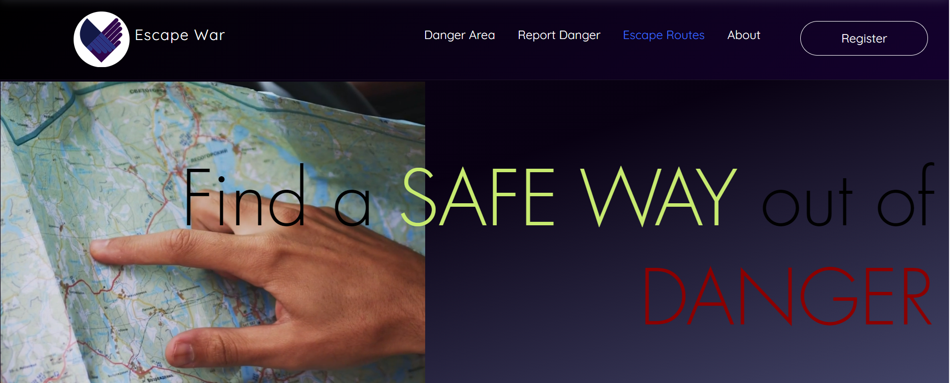
About us
1
2
3
4
5
Verification system
Accurate prediction
Variety of communication channels
Different types of services
Networking system
Both automated and human credibility by registration through humanitarian NGOS, detecting suspicious activity, document validation, necessary user geolocation tracking
Percentage of danger rate calculated from the number of data, provided by authentificated users only
Depending on users choice the safe escaping routes, shelters, humanitarian corridors and survival kit suggestion could be provided
The website is in constant touch with humanitarian aid agents
Alert notification provided by SMS, E-mail and app-notifications

Slide 5
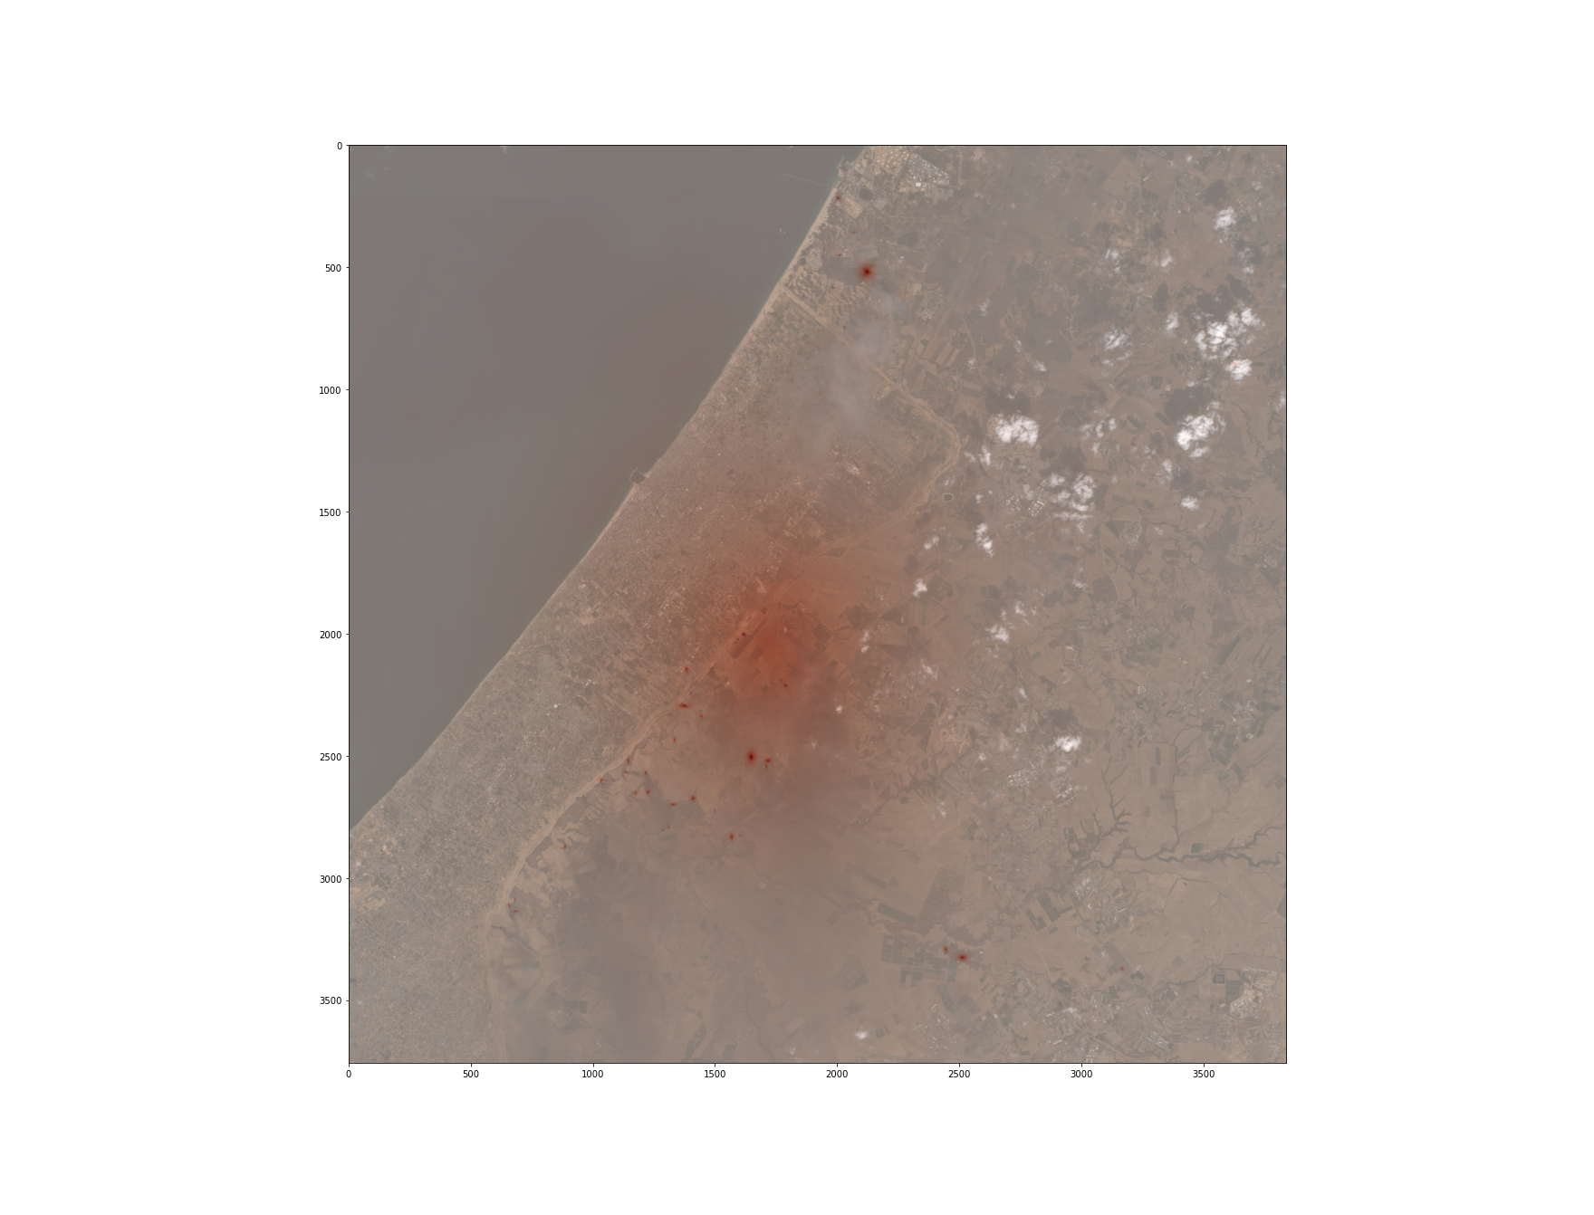
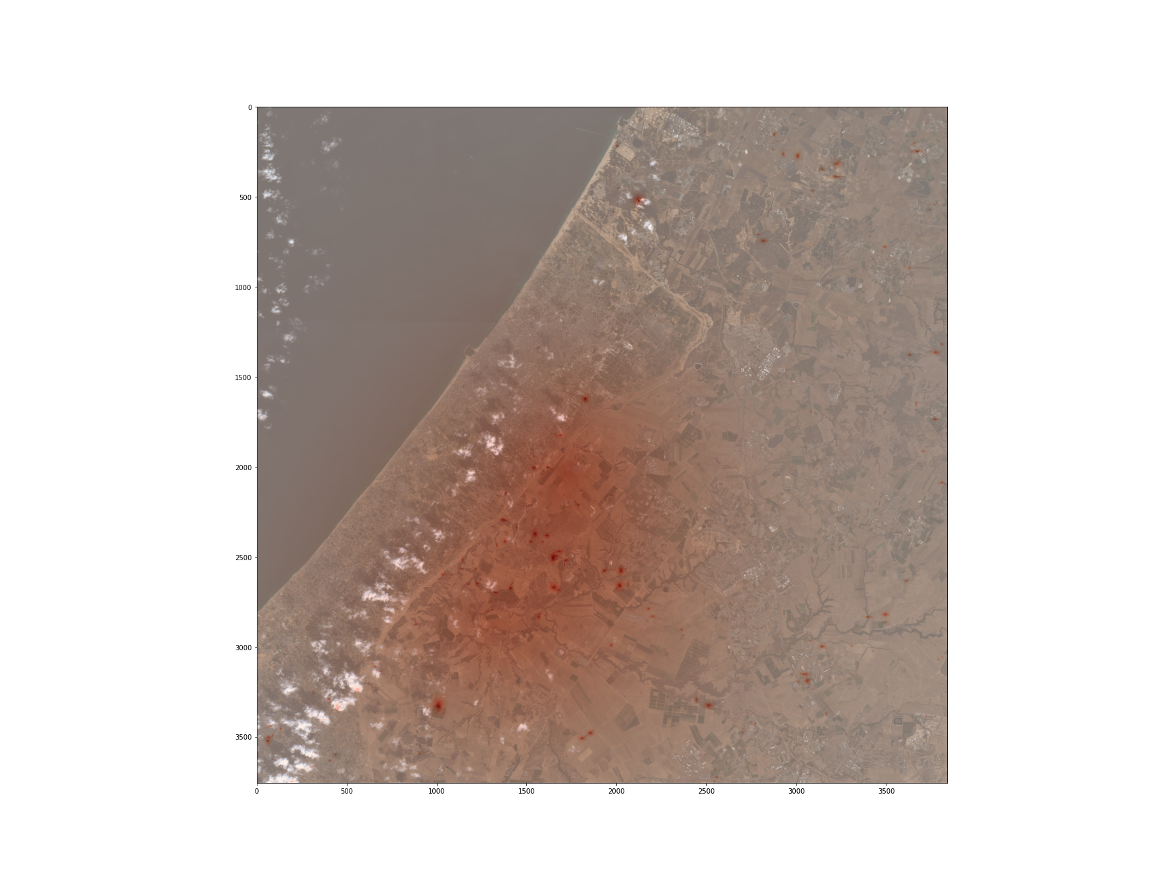
The North Eastern Part of the Gaza Strip
The pictures represent the danger hit maps generated by code based on satellite Sentinel-2 images
07/10/2023
22/10/2023

Slide 6
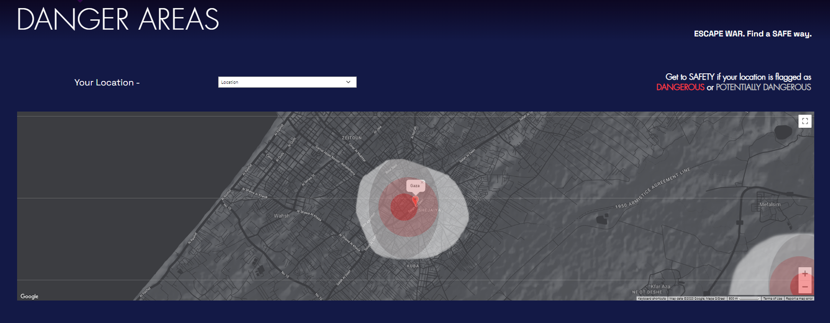


A user-friendly website providing the escaping routes and shelters for people in endangered areas
The data itself could be provided by manually processed remote sensing data and verified users input

Slide 7

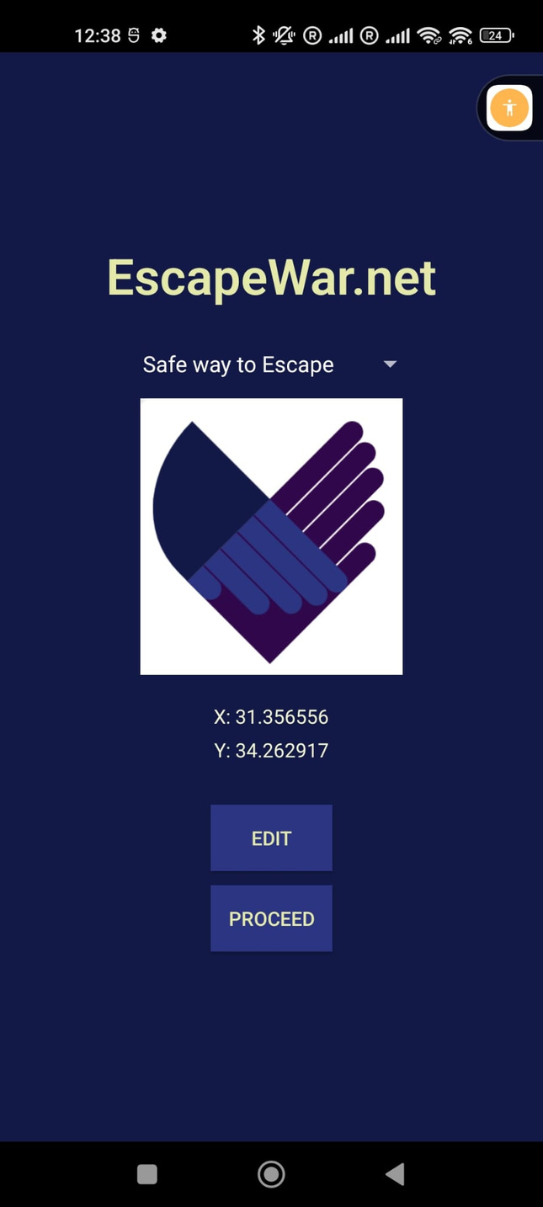
How can we help the world to be a safer place?
by one system considering all the problems at once...

Slide 8
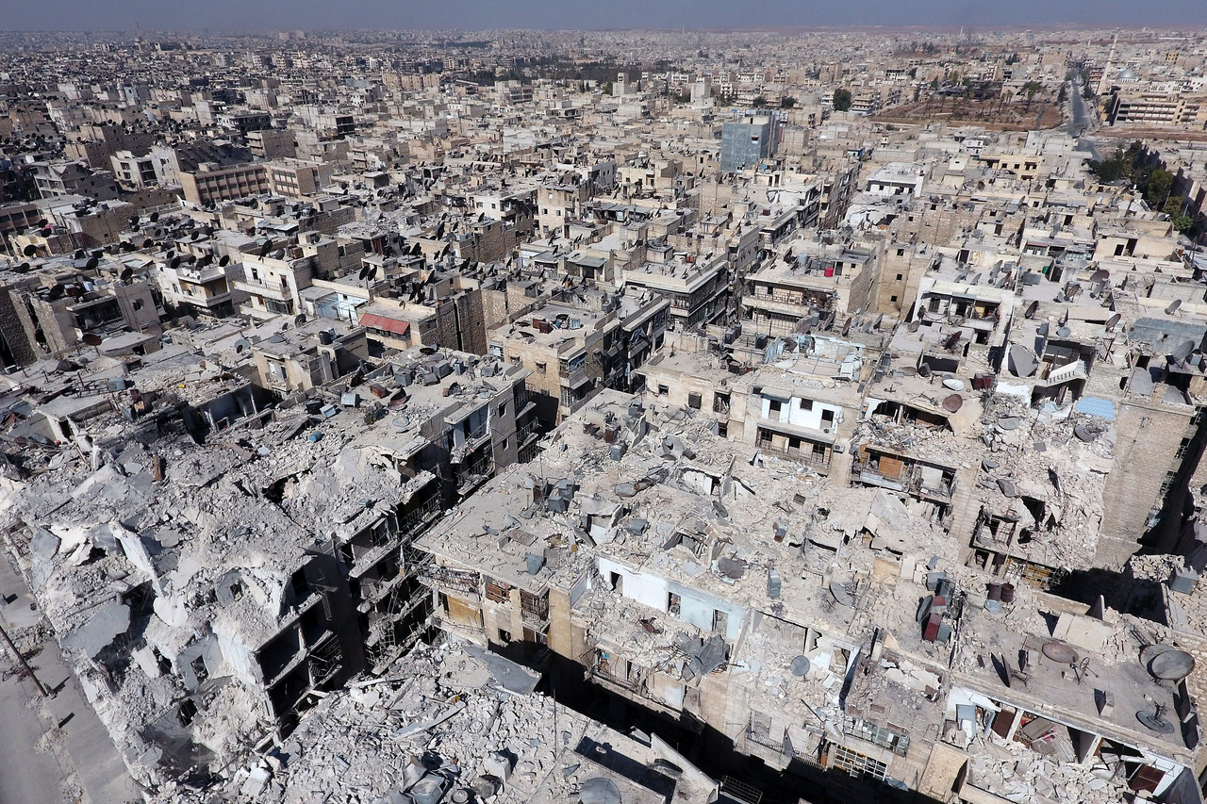
Business model
and why it is important...
27
ongoing military conflicts in 2023
238 000
dead because of the conflicts in 2022 (dw.com)
117 000 000
suffer from acute food insecurity as a result of armed conflict.

Slide 9
Our target customers and partners
International charity organisations
Member States Agences
Non-profitable organizations
Value Proposition:
Independent journalists
We are ready to provide accurate and constantly updating data for our potential customers. The project can give access to most safest ways to provide aid, organize a humanitarian corridor, and report on the current situation in the occupied area.
Telecommunication companies
Our users - civilians in areas of conflict.
All the data provided by the project is 100% free.
We offer safety for all who need it

Slide 10
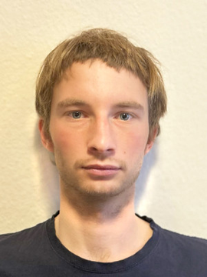


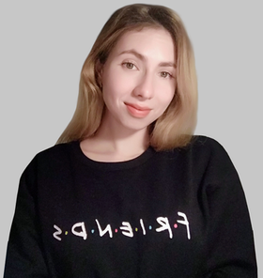
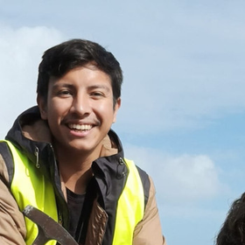
EscapeWar.Net team
Turning justice into code
Jakub Morawski
CEO. Project management and Technical Development.
Sarah Cader
CDO. UI and UX Creative. Start-up project manager.
Adrian Walczak
Technical EO Service Development. App creating.
Mariia Utkina
CMO. Business modeling and Value engineering.
Victor Lopez
CTO. Product development. GIS management.

Slide 11


Don't be indifferent!
stay in touch with us
https://sarahcader11.editorx.io/escapewarnet
email: jm.morawski@gmail.com

